Slide 1
Presentation Big Brother - 2. Milestone

Slide 2
Database

Slide 3
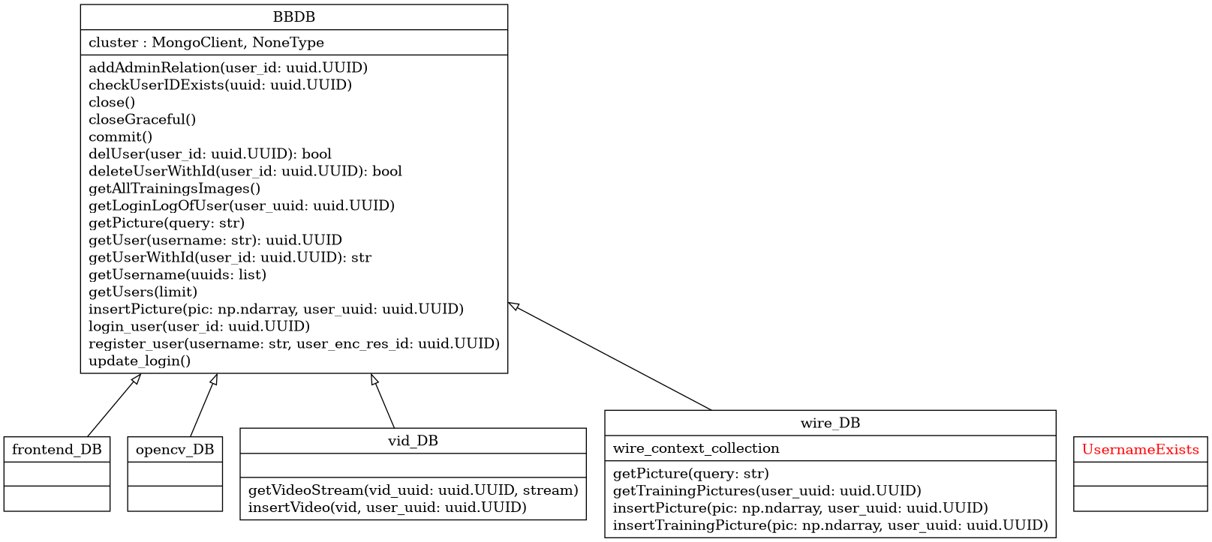
Database API Overview
12.06.2023

Slide 4
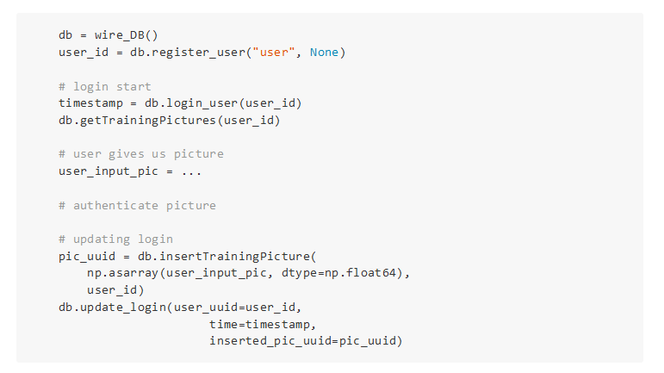
Example code: login
12.06.2023

Slide 5
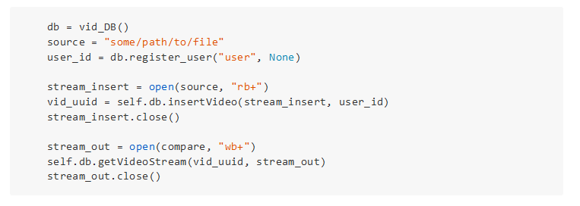
Example code: inserting videos
12.06.2023

Slide 6
TODOs
Fixing problems that arise when having users that access the
database concurrently
Implement further tests
Implement requests regarding features (mainly: vid_DB)
Group size: Only 1-2 people work in database group (more
people will work in the logic group)
12.06.2023

Slide 7
Frontend

Slide 8
(Frontend) 2. Milestone Done
Design:
new design of the homepage
Routes:
added missing routes
→ e.g. sign up and sign in with photo
Bug fixes with backend and logic Team
12.06.2023

Slide 9
(Frontend) TODO
Design:
Small refinements to the website
Routes:
Fix remaining interface issues e.g. login with camera
Adding new routes e.g. Face Regocnition
Users:
´Allow access to functionalities by multiple users

Slide 10
Logic

Slide 11
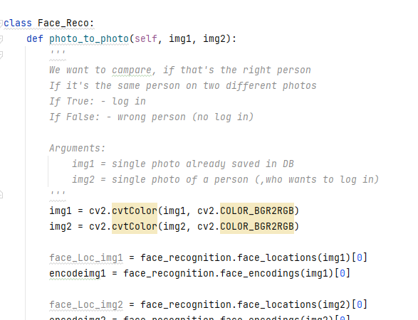
Logik (Face Recog)
Building of a class interface
for front-end to use
12.06.2023

Slide 12
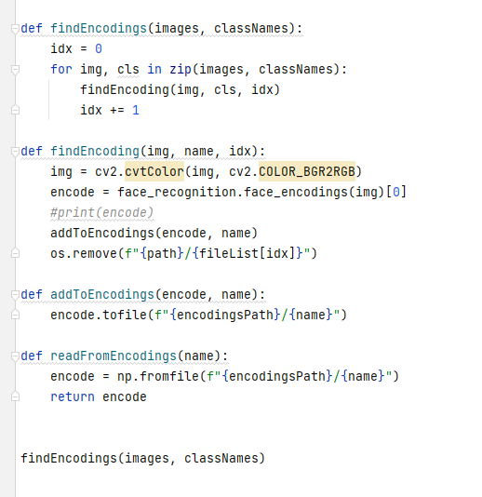
Logik (Face Recog)
Creating a script to encode faces once instead
every time the program is running
12.06.2023

Slide 13
Questions?

